Slide 1
Jointly Distributed Random Variables

Slide 2
Recap..

Slide 3
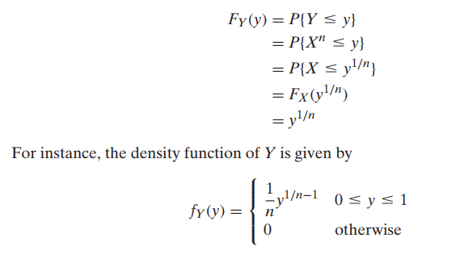

Slide 4
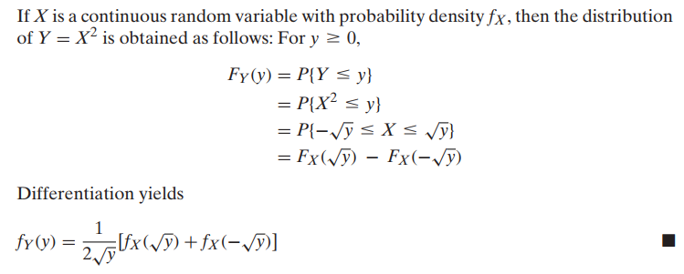

Slide 5
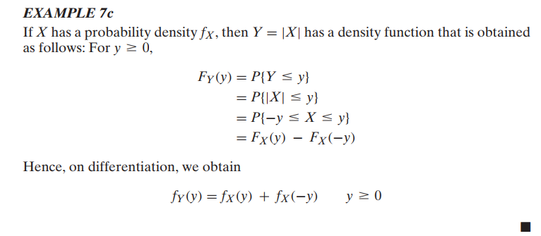

Slide 6

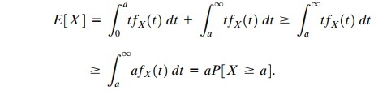
Markov Inequality
Mean of a non-negative random variable X do allow us to obtain bounds for probabilities

Slide 7

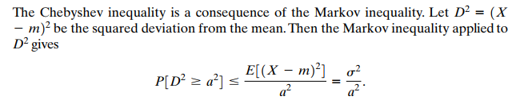

Slide 8
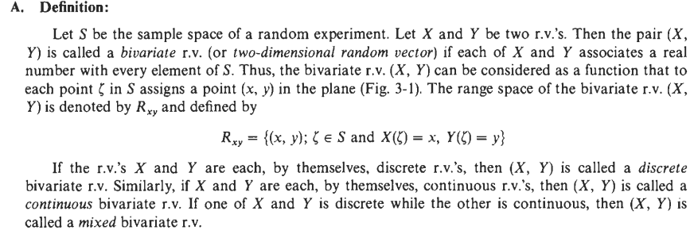
BIVARIATE RANDOM VARIABLES

Slide 9
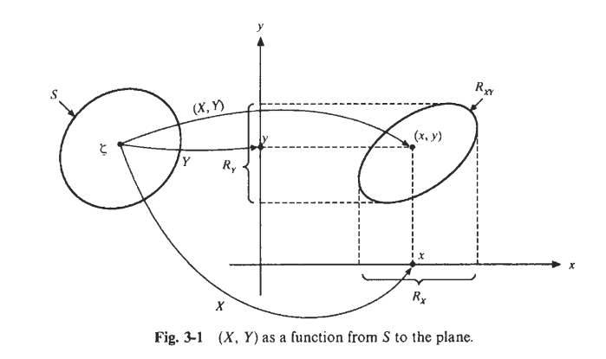

Slide 10
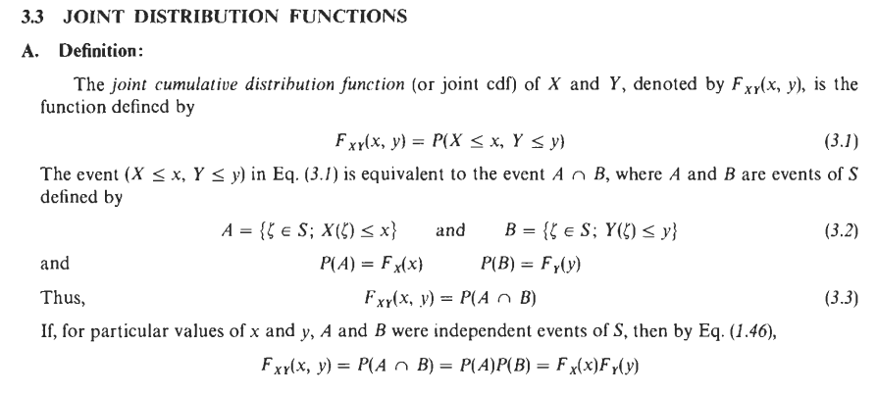

Slide 11
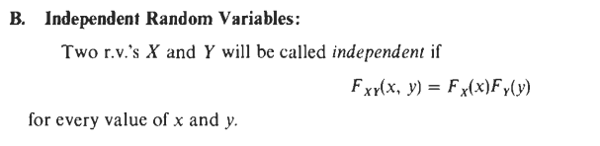

Slide 12
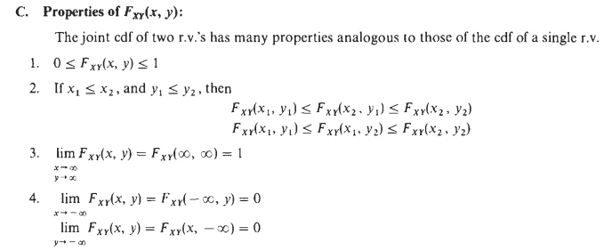

Slide 13
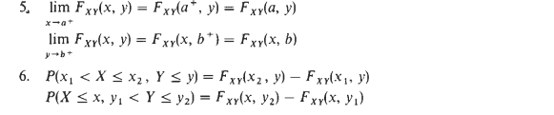


Slide 14
Jointly Distributed RVs
In general, if X and Y are two random variables, the probability distribution that defines their simultaneous behavior is called a joint probability distribution.
For example: X : the length of one dimension of an injection-molded part, and Y : the length of another dimension. We might be interested in
P(2.95 ≤ X ≤ 3.05 and 7.60 ≤ Y ≤ 7.80).

Slide 15
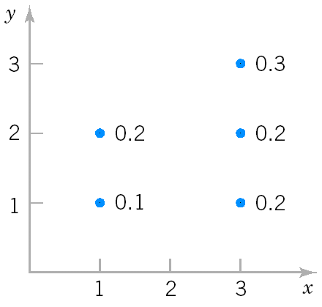
Discrete Joint Probability Distributions
The joint probability distribution of two discrete random variables X,Y is usually written as f_{XY}(x,y)= Pr(X=x, Y=y). The joint probability function satisfies
Example 6: X can take only 1 and 3; Y can take only 1,2 and 3 ; and the joint probability function of X and Y is:
Compute P(X≥2, Y≥2)
(2) Compute P(X=3)
Joint distribution of X and Y

Slide 16
Compute P(X≥2, Y≥2)
P(X≥2, Y≥2)=P(X=3,Y=2)+P(X=3,Y=3)=0.2+0.3=0.5
(2) Compute Pr(X=3)
P(X=3)=P(X=3,Y=1)+P(X=3,Y=2)+P(X=3,Y=3)=0.2+0.2+0.3=0.7

Slide 17
Marginal Probability Distributions (Discrete)
Marginal Probability Distribution: the individual probability distribution of a random variable computed from a joint distribution.
Notes:
In other words, for every value x, the value of fX(x) is found by summing fXY(x,y) over all possible values y of Y.

Slide 18
Marginal Probability Distributions (Discrete, Example)
Compute f_{X}(1), f_{X}(3), f_{Y}(1), f_{Y}(2) and f_{Y}(3) in Example 6 .
f_{X}(1)=P(X=1,Y=1)+P(X=1,Y=2)=0.1+0.2=0.3
f_{X}(3)= P(X=3,Y=1)+P(X=3,Y=2)+ P(X=3,Y=3)=0.2+0.2+0.3=0.7
f_{Y}(1)= P(X=1,Y=1)+P(X=3,Y=1)=0.1+0.2=0.3
f_{Y}(2)=P(X=1,Y=2)+P(X=3,Y=2)=0.2+0.2=0.4
f_{Y}(3)= P(X=3,Y=3)=0.3

Slide 19
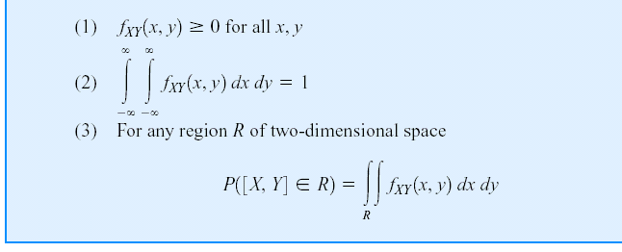
Continuous Joint Distributions
A joint probability density function for the continuous random variables X and Y, denotes as f_{XY}(x,y), satisfies the following properties:

Slide 21
Continuous Joint Distributions (Example 7)
Calculating probabilities from a joint p.d.f.

Slide 22
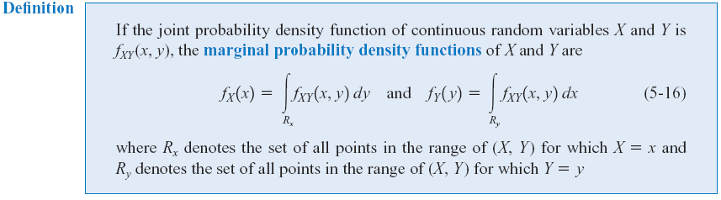
Marginal Probability Distributions(Continuous)
Similar to joint discrete random variables, we can find the marginal probability distributions of X and Y from the joint probability distribution.

Slide 23
Marginal Probability Distributions(Continuous, Example)
Compute f_{X} (x) and f_{Y}(y) in Example 7

Slide 24
Independence
In some random experiments, knowledge of the values of X does not change any of the probabilities associated with the values for Y.
If two random variables, X and Y are independent, then

Slide 25
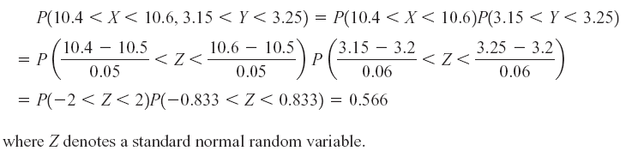
Independence (Example 8)
Let the random variables X and Y denote the lengths of two dimensions of a machined part, respectively.
Assume that X and Y are independent random variables, and the distribution of X is normal with mean 10.5 mm and variance 0.0025 (mm)² and that the distribution of Y is normal with mean 3.2 mm and variance 0.0036 (mm)².
Determine the probability that 10.4 < X < 10.6 and 3.15 < Y < 3.25.
Because X,Y are independent

Slide 26
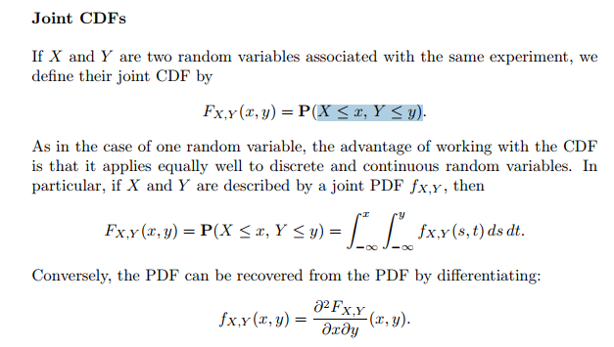

Slide 27

Function of random Variable Find the CDF and PDF of Y

Slide 28
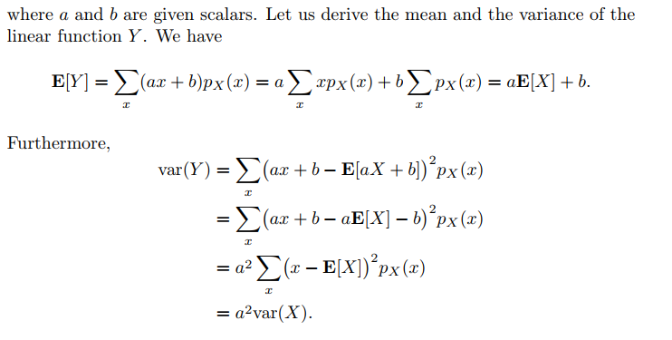

Slide 30
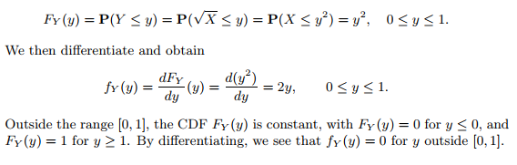

Slide 31


Slide 32
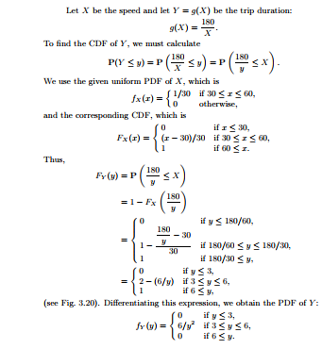

Slide 33


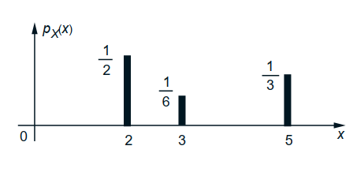

Moment Generating Function

Slide 34
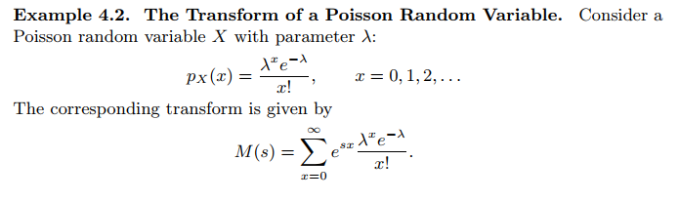
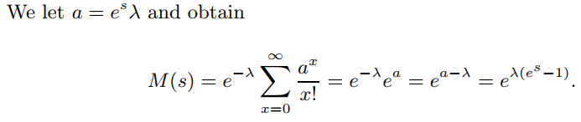

Slide 35
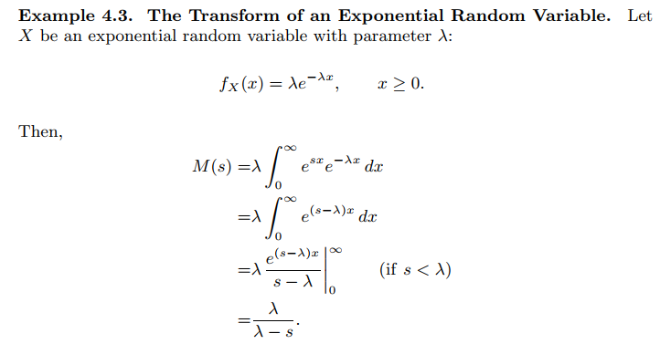

Slide 36
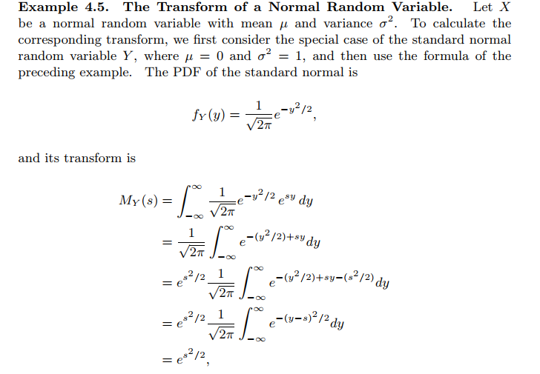

Slide 37
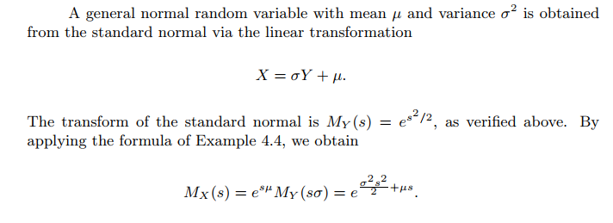

Slide 38
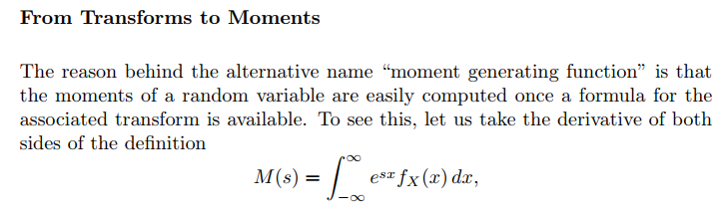
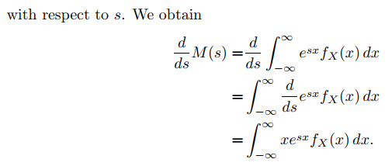

Slide 39
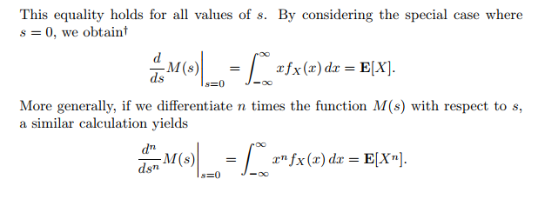

Slide 40
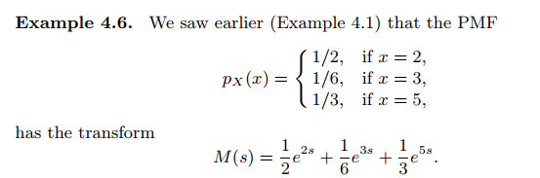
Find mean and variance using MGF

Slide 41
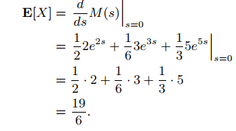
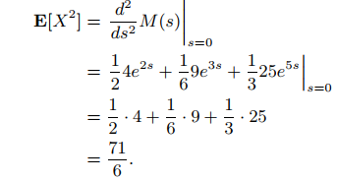

Slide 42
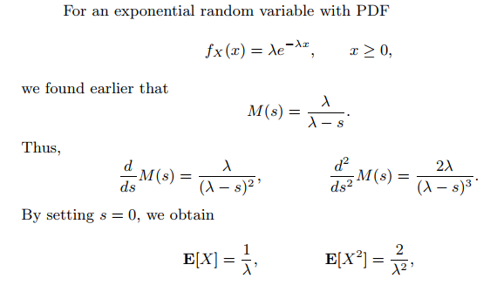

Slide 43
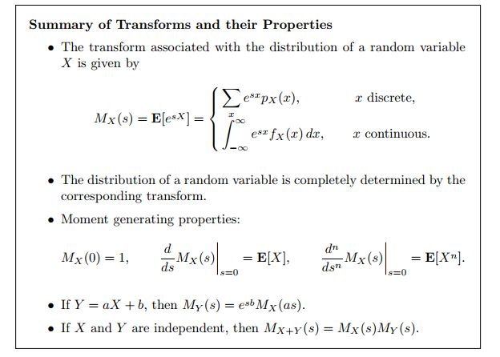

Slide 44
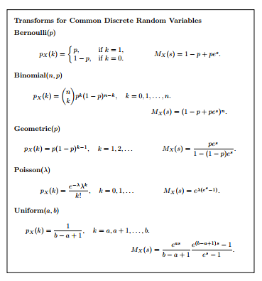

Slide 45
Covariance and Correlation Coefficient
The covariance between two RV’s X and Y is
Properties:
The correlation Coefficient of X and Y is
Notes:
When we are interested in the joint distribution of two random variables, it is useful to have a summary of how much the two random variables depend on each other. The covariance and correlation are attempts to measure that dependence.

Slide 46
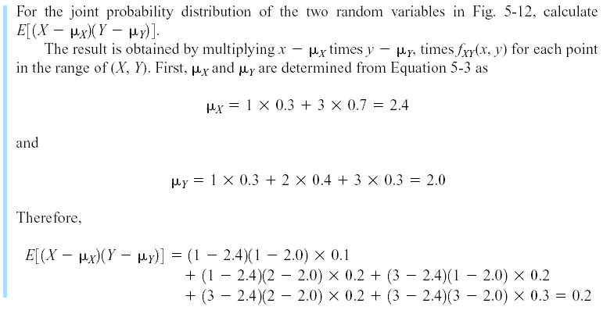
Covariance and Correlation (Example 6 (Cont.))
Marginal PMF
f_{X}(1)=P(X=1,Y=1)+P(X=1,Y=2)=0.1+0.2=0.3
f_{X}(3)= P(X=3,Y=1)+P(X=3,Y=2)+ P(X=3,Y=3)=0.2+0.2+0.3=0.7
f_{Y}(1)= P(X=1,Y=1)+P(X=3,Y=1)=0.1+0.2=0.3
f_{Y}(2)=P(X=1,Y=2)+P(X=3,Y=2)=0.2+0.2=0.4
f_{Y}(3)= P(X=3,Y=3)=0.3

Slide 47
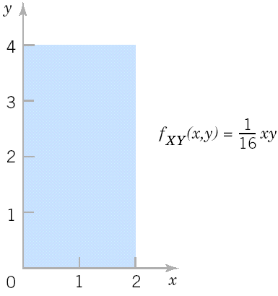
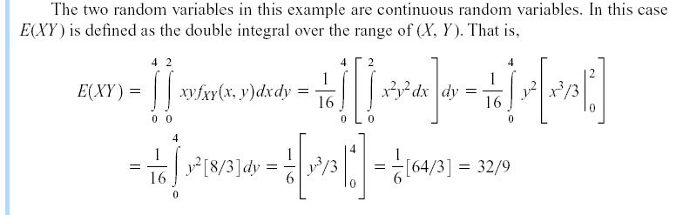
Covariance and Correlation
Example 9

Slide 48
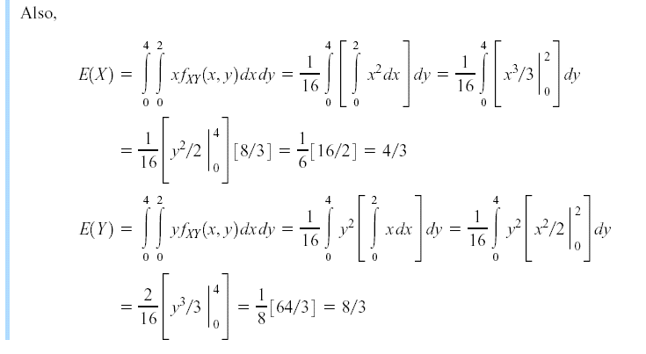
Covariance and Correlation
Example 9 (Cont.)

Slide 49
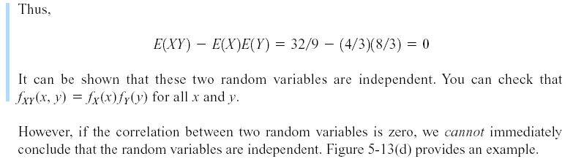
Covariance and Correlation
Example 9 (Cont.)

Slide 50
Zero Covariance and Independence
However, in general, if Cov(X,Y)=0, X and Y may not be independent.
Example 10: X is uniformly distributed on [-1,1], Y=X² . Then,
Cov(X,Y)= 0, but X determines Y, i.e., X and Y are not independent.
If X and Y are independent, then Cov(X,Y)=0.

Slide 51
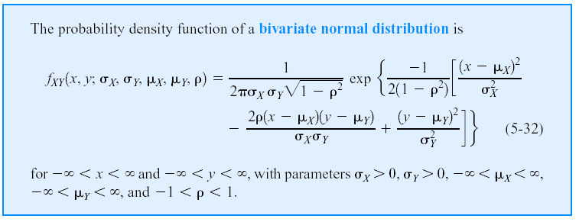
Bivariate Normal Distribution
Notes:
ρ: Correlation coefficient X, Y are independent if ρ = 0
The bivariate normal distribution is the joint distribution of certain linear combinations of independent random variables havign standard normal distributions. The bivariate normal distribution arises directly and naturally in many practical problems. For examle, the heights and the weights of the individuals in the population will be approximately a bivariate normal distribution.

Slide 52
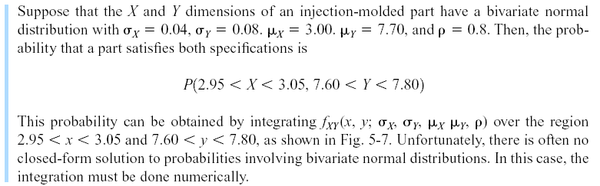
Bivariate Normal Distribution
Example 11
Notes:
Unfortunately, there is often no closed-form solution to probabilities involving bivariate normal distributions. In this case, the integration must be done numerically.

Slide 53
Bivariate Normal Distribution (Matlab)
y = mvncdf(xl,xu,mu,SIGMA) returns the multivariate normal cumulative probability with mean mu and covariance SIGMA evaluated over the rectangle with lower and upper limits defined by xl and xu, respectively. mu is a 1-by-d vector, and SIGMA is a d-by-d symmetric, positive definite matrix.
Examples 11 (Cont.)
mu=[3.00 7.70]; SIGMA=[0.0016 0.00256; 0.00256 0.0064];
XL=[2.95 7.60];
XU=[3.05 7.80];
>> p=mvncdf(XL,XU, mu,SIGMA)
p =
0.6975

Slide 54
Probability Distributions-II: Multidimensional Random Variables, DFs, Marginal Distributions, Discrete and Continuous Random Variables in two dimensions, Conditional Distributions, Transformation of continuous random variables in two dimensions. ● Mathematical Expectation-II: Expectation of Two-dimensional Distributions, Moments, Covariance and Correlation Coefficients, Conditional Expectations-Regression Curves, Principle of Least Squares-Regression Lines, M.G.F., Joint Characteristic Functions, Reproductive Property. ● Convergence of a Sequence of Random Variables and Limit Theorems: Convergence in Probability and Convergence in Distribution, Tchebycheff’s Inequality and Theorem, Bernoulli’s Theorem, Law of Large Numbers. Asymptotically Normal Distribution, Limit Theorem for Characteristic Functions, Central Limit Theorem, DeMoivre Laplace Limit Theorem. ● Some Important Continuous Distributions: Chi-square Distribution, t-Distribution, F Distribution and important statistics.

